Slide 1

Classification of Pneumonia Chest X-ray among COVID-19 patients using CNN
Karthik Garimella, Sandeep Alfred, Sanjeev Raichur
SAT 5165 Intro to Big Data Analytics - Fall 2024
‹#›

Slide 2
Problems intended to be solved:
The main idea of this project is to leverage CNN to recognise specific patterns in Pneumonia patients.
The 2019 coronavirus (COVID-19) presents several unique features for Pneumonia patients. CNN’s image recognition capabilities can be used on the chest X-rays of patients to determine if the patient has Pneumonia.
A deep learning model is developed to identify pneumonia patterns on X-rays of COVID-19 patients. Spark will be used for big image data analysis in a distributed environment.
‹#›

Slide 3
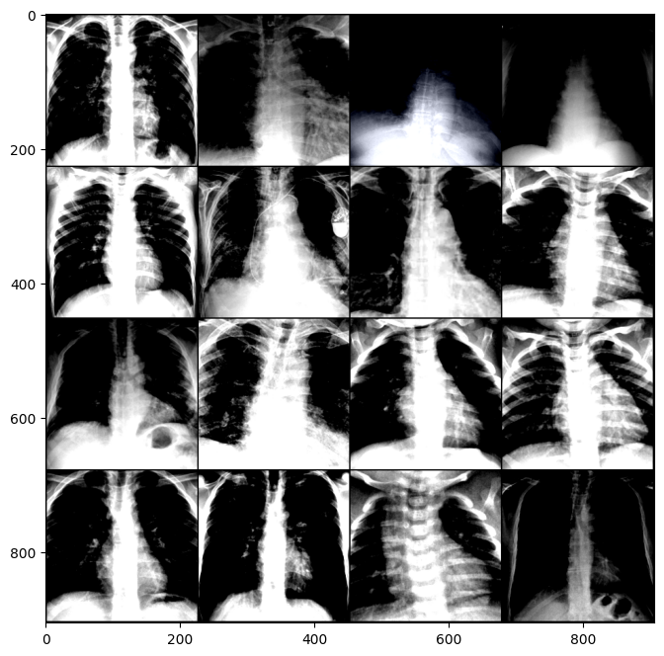
Data
The data is taken from: https://www.kaggle.com/datasets/khoongweihao/covid19-xray-dataset-train-test-sets/data
The dataset was created by Joseph Paul Cohen and Paul Morrison and Lan Dao. COVID-19 image data collection, arXiv, 2020. https://github.com/ieee8023/covid-chestxray-dataset.

Slide 4
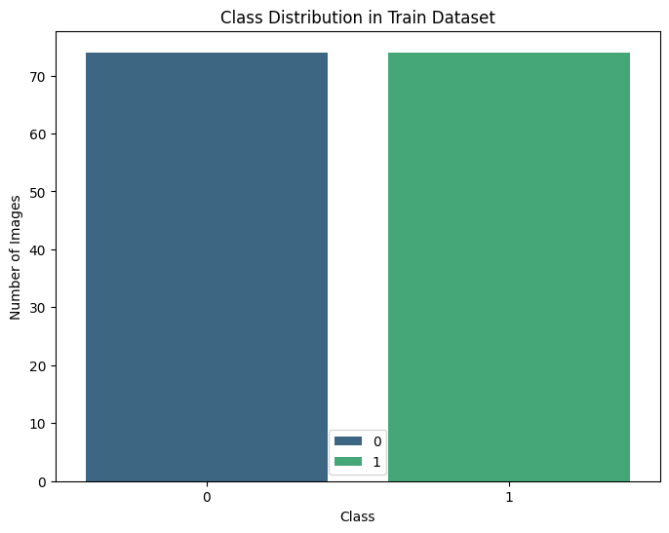
Data
The data is split into Train and Test by default, in an approximate 80-20 split. The response variable is perfectly balanced.
Sample size: 188 images
Train Frequency: 74 True and 74 False
Test Frequency: 20 True and 20 False

Slide 5
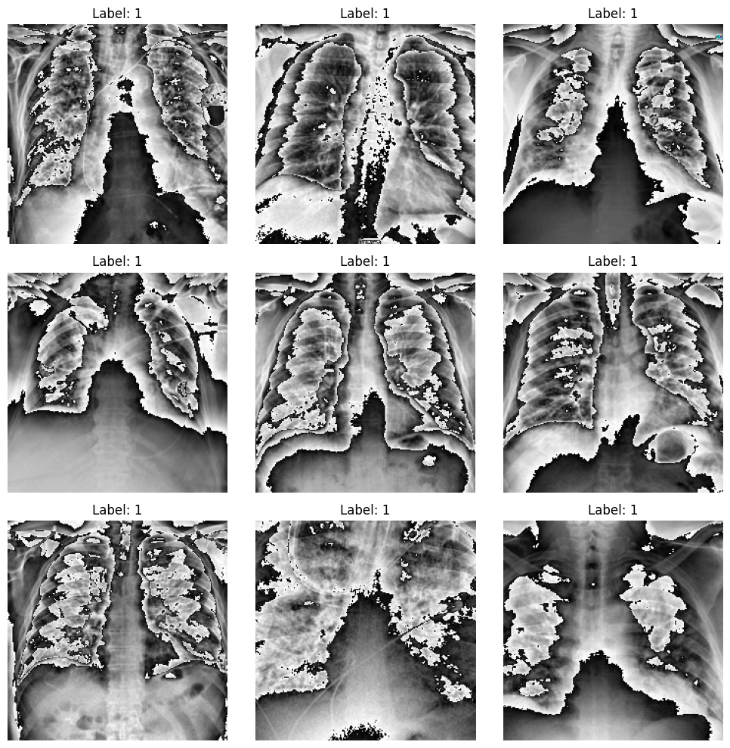
Data Augmentation
Resizing some of the images
CenterCrop images to create sets focused on the center of the image
Normalized the images to improve pixel density.

Slide 6
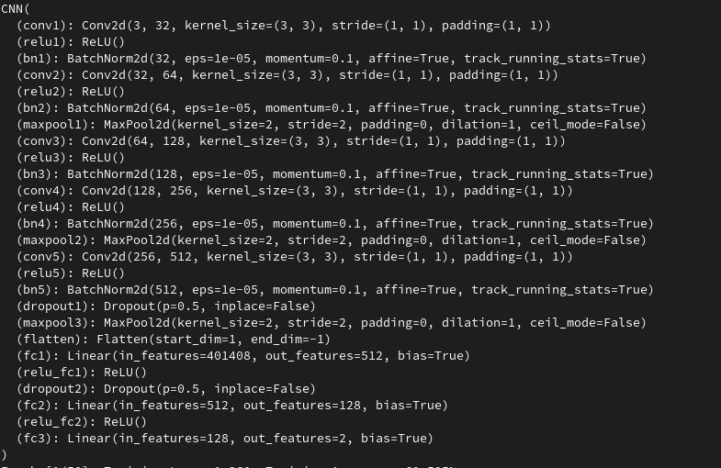
CNN Architecture

Slide 7
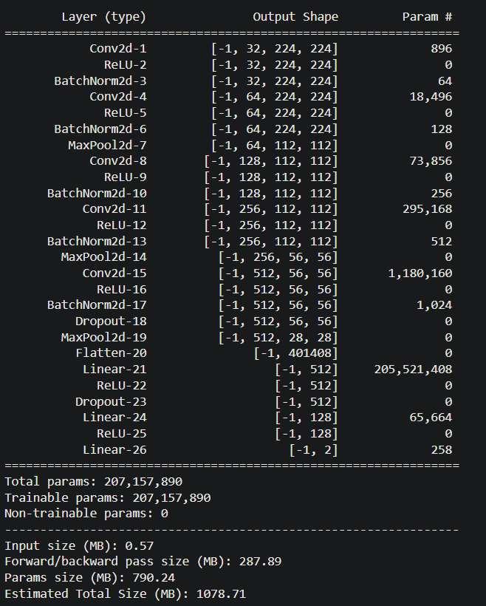
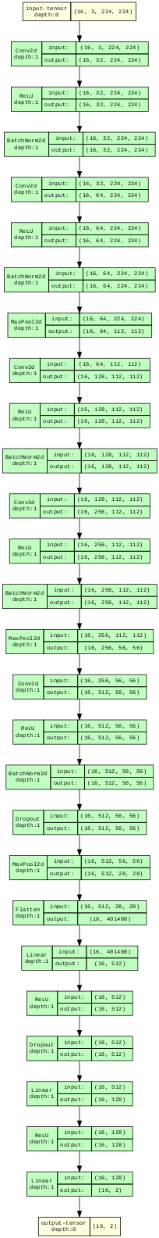
CNN Architecture

Slide 8
Model Hyperparameters
Criterion: CrossEntropyLoss
Batch Size: 16
Optimizer: Adam
Learning Rate: 0.0001
Epochs: 50
Scheduler: StepLR with Stepsize = 1, Gamma = 0.7

Slide 9
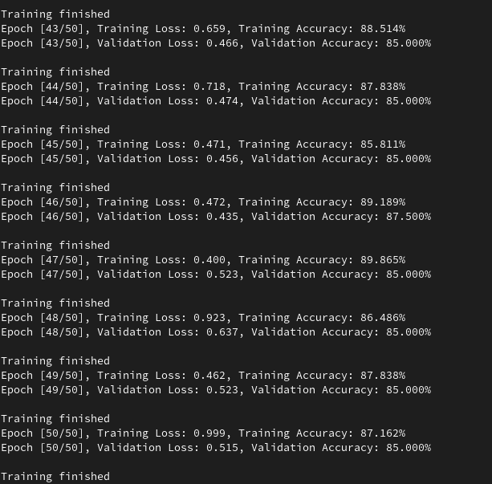
Model Training and Summary

Slide 10
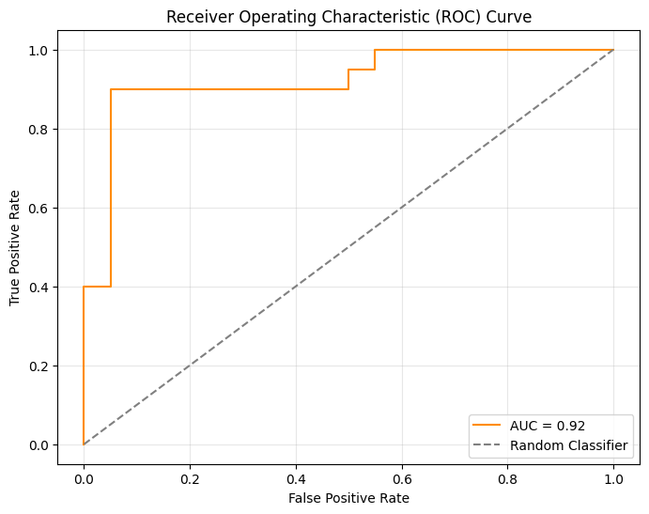
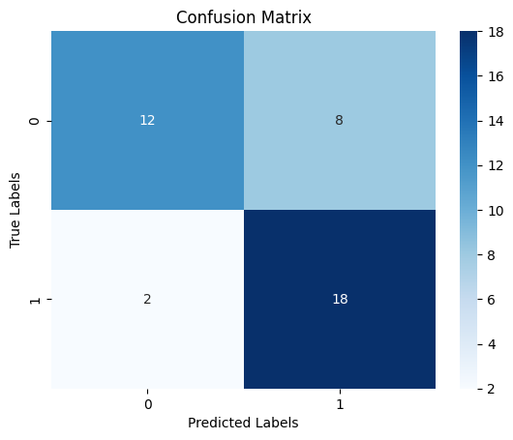
Model Performance

Slide 11
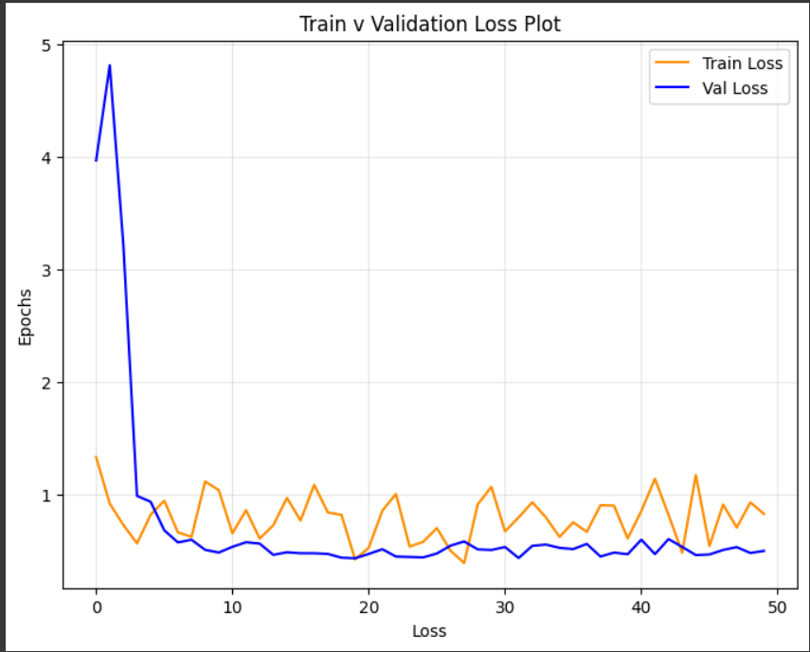
Model Performance

Slide 12
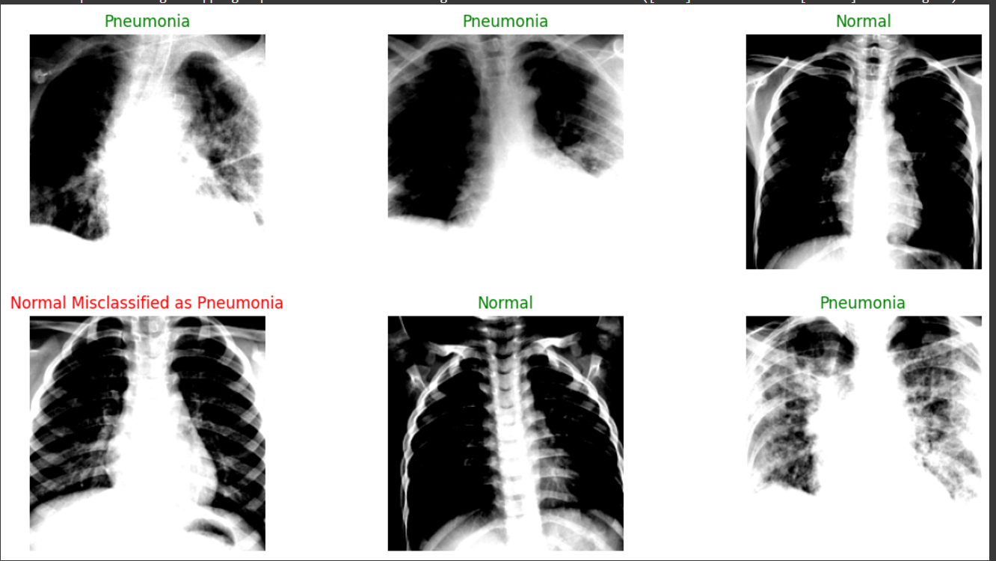
Model Performance

Slide 13
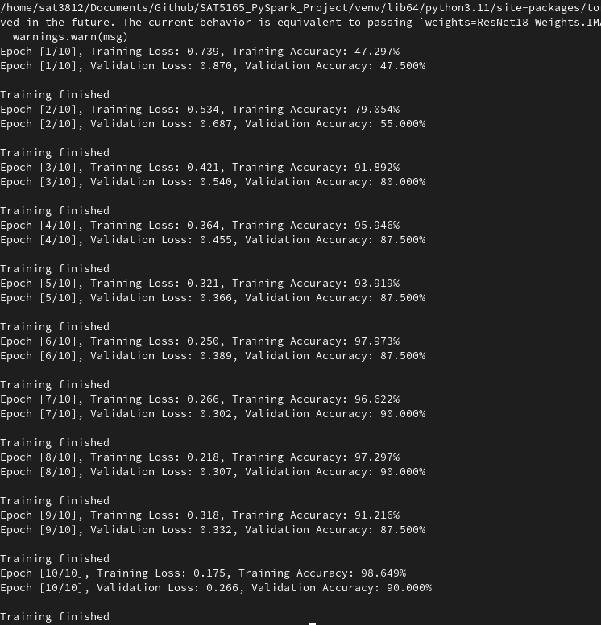
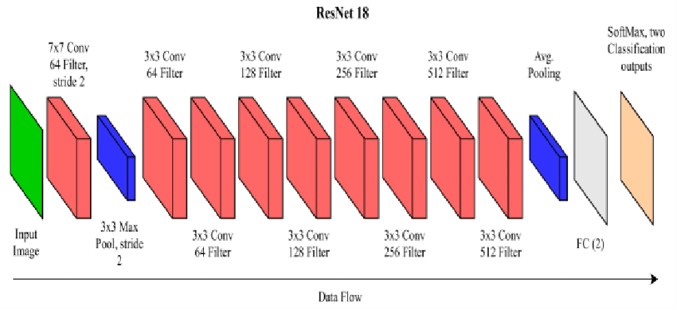
Transfer Learning: ResNet18

Slide 14
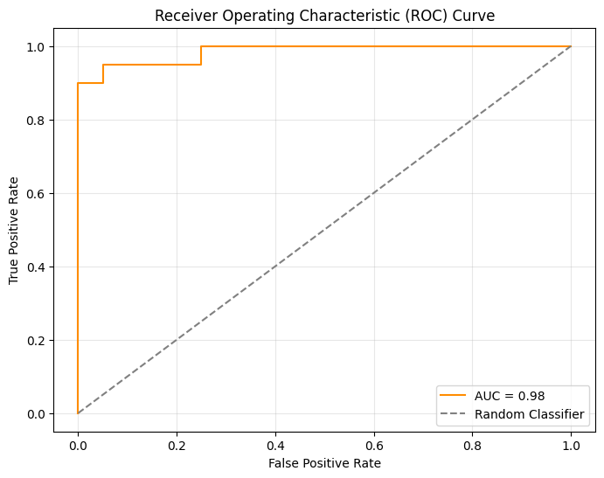
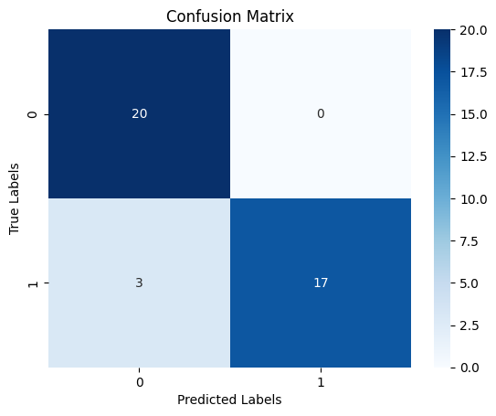
ResNet18 Model Performance

Slide 15
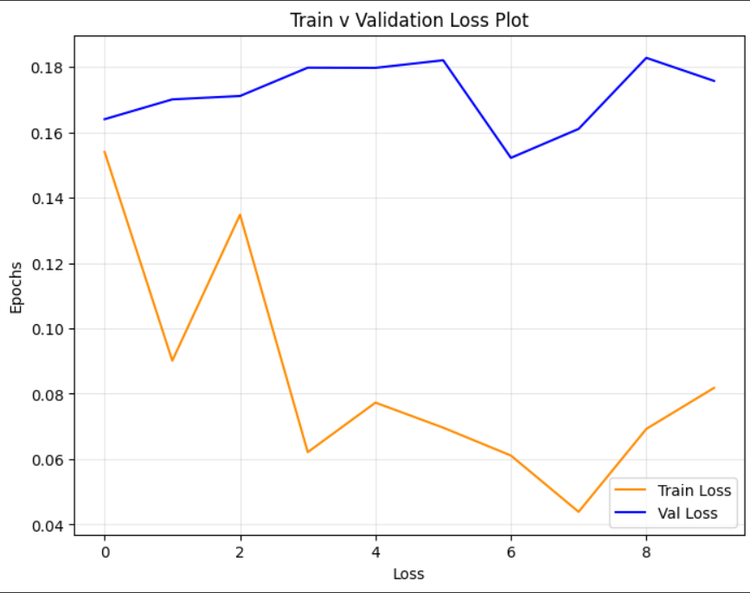
ResNet18 Model Performance

Slide 16
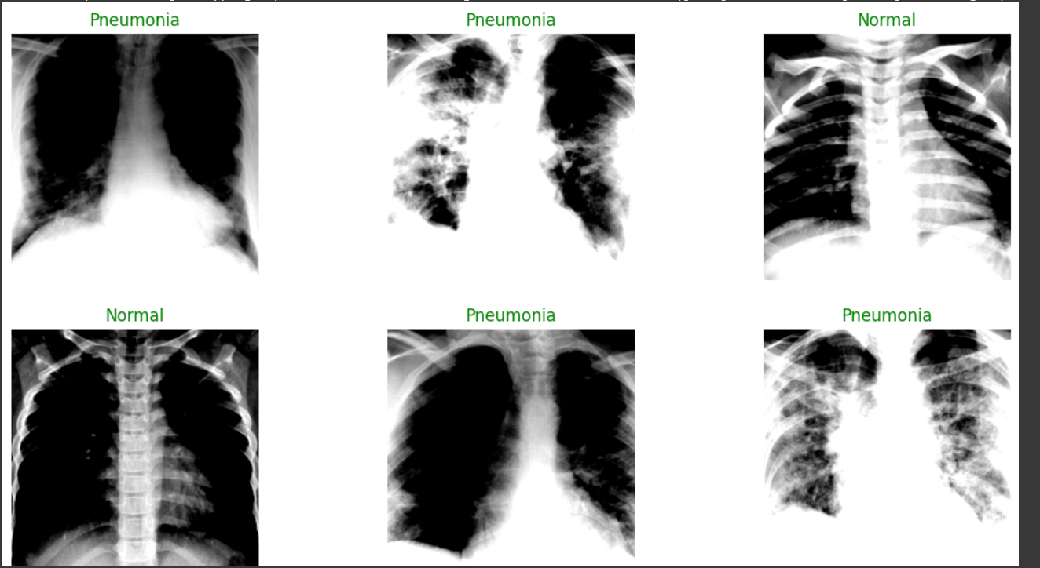
ResNet18 Performance

Slide 17
Conclusion
Pretrained ResNet 18 model is better.
Higher Accuracy (Recall, F1-score), Lower Loss.
Better Optimized, fewer tuning efforts.

